Slide 1
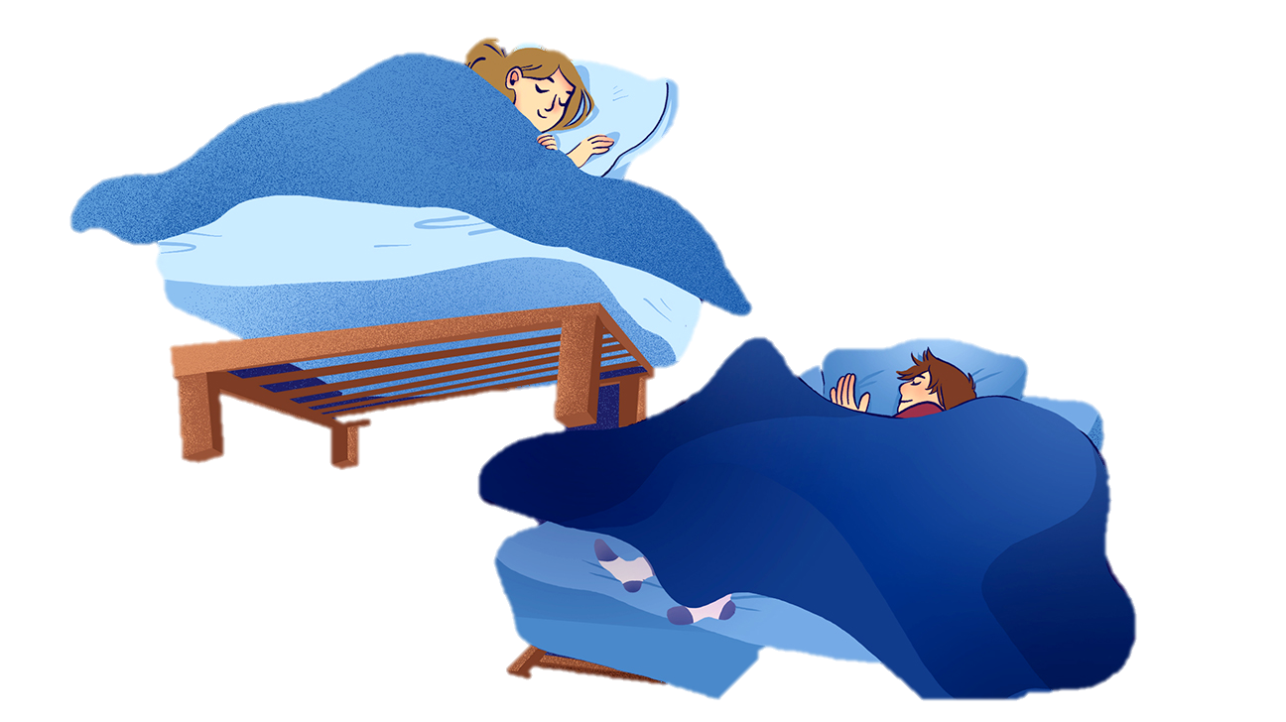

English 101 – Week 4
Theme of life balance: sleep, exercise, playtime

Slide 2
From last week - listening
Go now to review your answers to the TEDTalk video ”Get Hooked on Nature”

Slide 3
From your homework (1)
You prepared a short speech for the people in your programme who are a little down. The information came from a text you read for homework
You will give your speech in small groups of three people. Each person will present to two others, even though the subject is the same.
When your partners are presenting, you must evaluate them.

Slide 4
From your homework (2)
Here is the procedure:
Download the speaking evaluation grid under “files”, “week 4.”
Join your groups, camera and microphones on
Present to each other and give your teammates constructive comments based on the criteria in the evaluation grid
After 15 minutes, return to “general”

Slide 5
Reading test
Reading text
Link will be available in the chat
It is in pdf format
Reading questions
Questions are in “assignments”

Slide 6
Reading and listening
The class will be divided into 3 groups. Each group will watch and listen to a different video.
You must be sure that you understand the content of your video and be ready to explain it to someone else.
Group 1
link to text
Your text gets a bit technical. Just try to understand the main ideas. You don’t need to explain the details
Group 2
link to text
Your text contains a lot of details. Try to understand the main ideas for a summary
Group 3
link to text
Just watch the video on this page, no need to read the text as well

Slide 7
Listening text – group summaries
Meet with the other people who watched the same video as you. Compare your ideas to ensure you have a clear understanding of the contents of the video.
If you have time to create a group summary, great.

Slide 8
Listening texts - sharing
Now, you will share what you learned with other students who didn’t watch your video:
A
B
C
D
Group 1 student
Group 1 student
Group 2 student
Group 2 student
Group 3 student
Group 3 student
Group 1 student
Group 1 student
Group 2 student
Group 2 student
Group 3 student
Group 3 student
Group 1 student
Group 1 student
Group 2 student
Group 2 student
Group 3 student
Group 3 student
Group 1 student
Group 1 student
Group 2 student
Group 2 student
Group 3 student
Group 3 student
Etc.

Slide 9
Homework
Review what you learned about life balance.
Create 10 questions that you could ask a friend, a relative, a colleague, or a stranger to find out about his or her life balance.
Revise your questions for grammatical accuracy and ensure that they reflect the ideas learned in this theme.
Next week: Listening test (it counts!)

